Slide 1

Alter-Native
Make your applications become native

Slide 2
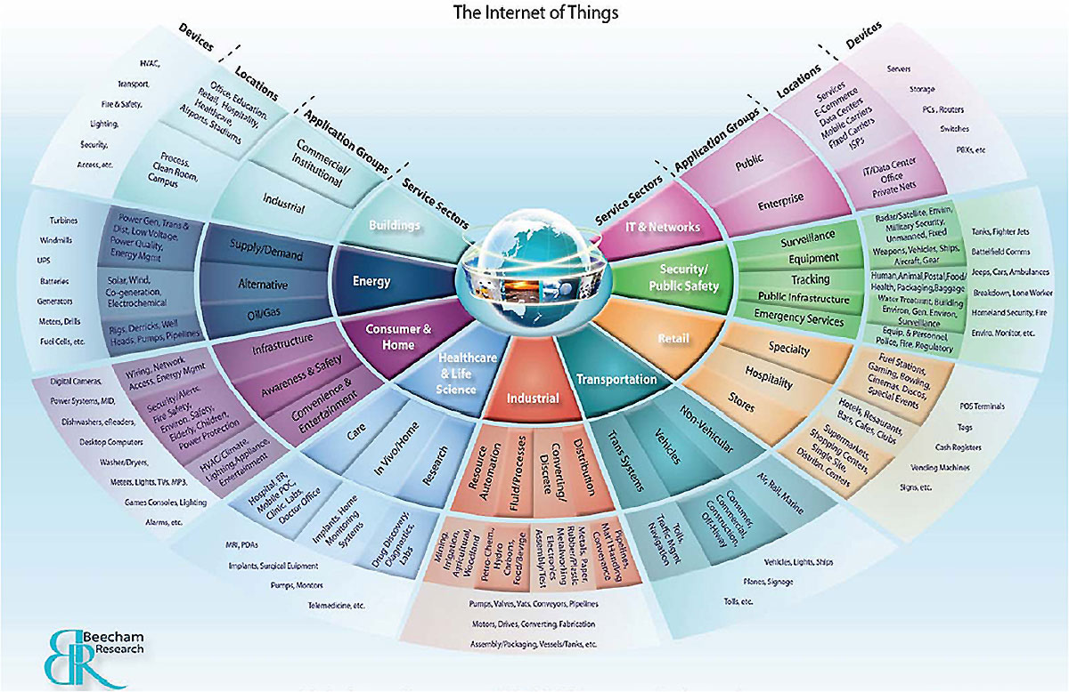
IoT Future

Slide 3
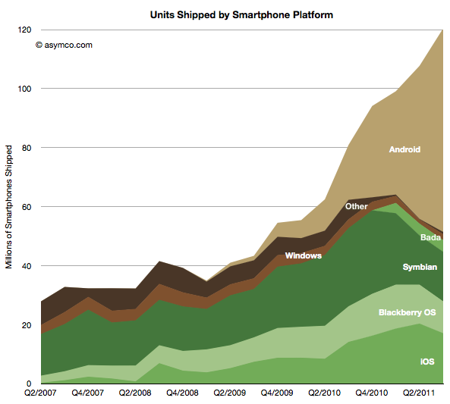
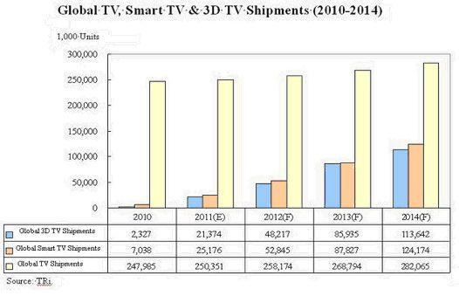
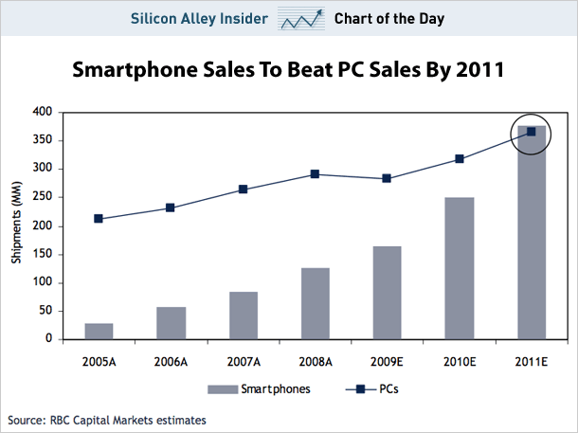
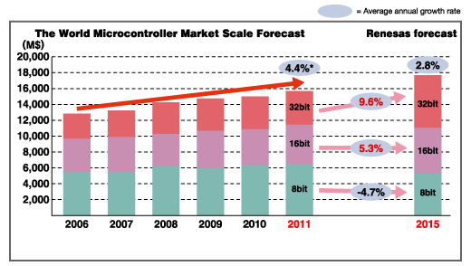
Devices market

Slide 4
Concept
Unix
Android
Linux
Microsoft
Windows
Apple
Mac
iOS
Embedded systems
C++

Slide 5

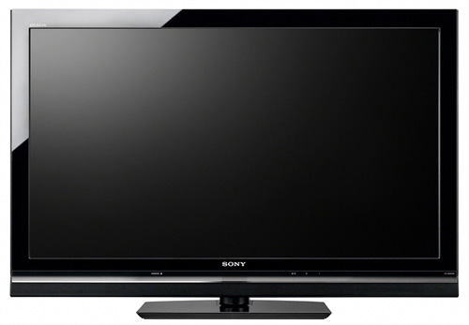


Concept II
Assembly
.EXE
.DLL
Source Code
C#
Source Code
C++
Assembly
Native
.exe
App1?
Applications database
Cloud services
Automatic translation

Slide 6
Application
Application
Logic
Model
Drivers
View
HTML5
OpenGL ES

Slide 7
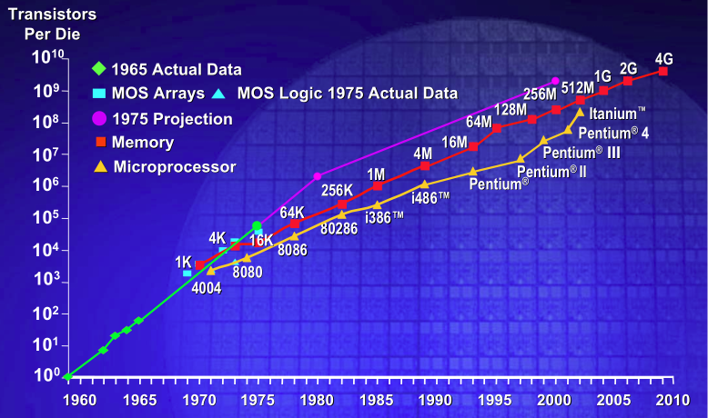
Moore’s law
Powerful systems
More embedded possibilities

Slide 8
Use cases
Mobile
Set-top boxes
Embedded

Slide 9
SoA (I)
General research lines
Code translation
Memory management
Visual content translation
Open libraries
OpenGL
HTML5/CSS
Javascript

Slide 10
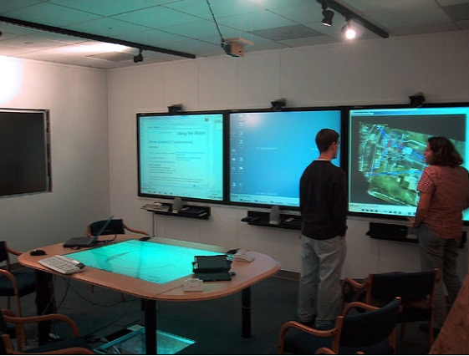
SoA (II)
iROS, iRoom and iStuff
Stanford University
Computer Science Department
Ubiquitous computing
Adaptative interfaces
On the fly generation
Hardware abstraction
iStuff: Physical devices for ubiquitious computing
iROS: Framework for create interactive rooms with user interfaces
iRoom: Project developed over iROS and iStuff
Jan Borchers, Meredith Ringel, Joshua Tyler, and Armando Fox, “Stanford Interactive Workspaces: A Framework for Physical and
Graphical User Interface Prototyping”, Computer Science Department, Stanford University
Notes:
http://hci.stanford.edu/research/istuff/iRoom_SmartHomes.pdf

Slide 11

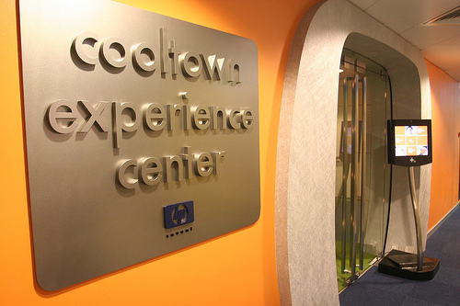
SoA (III)
Cooltown project
Smart city
Ubiquitous computing
Collaborative sensors
Web representation
Adaptative interfaces
John J. Barton and Tim Kindberg, “The Cooltown User Experience”, Internet and Mobile Systems Laboratory, Hewlett Packard Laboratories, Palo Alto, CA 94304
Notes:
http://www.hpl.hp.com/techreports/2001/HPL-2001-22.pdf

Slide 12
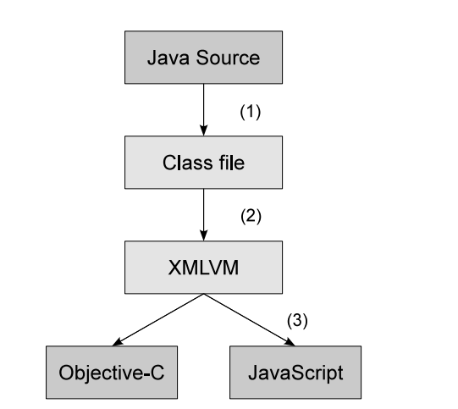
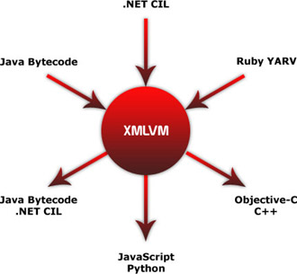
SoA (IV): Mobile
Smartphone Cross-Compilation Framework for
Multiplayer Online Games
San Francisco State University
Department of Computer Science
Notes:
http://ieeexplore.ieee.org/xpl/login.jsp?tp=&arnumber=5430005&url=http%3A%2F%2Fieeexplore.ieee.org%2Fstamp%2Fstamp.jsp%3Ftp%3D%26arnumber%3D5430005

Slide 13
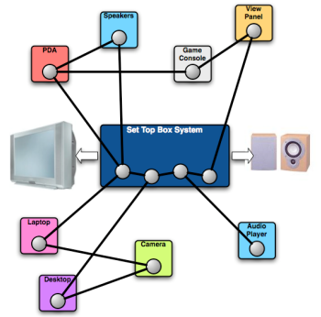
SoA (V): Set-Top Boxes
An Extensible Set-Top Box Platform
for Home Media Applications
Middleware based
Exchange capabilities between devices
Exchange information
Exchange multimedia
Exchange codecs
Centralized control GUI
Notes:
http://ieeexplore.ieee.org/stamp/stamp.jsp?tp=&arnumber=1561841

Slide 14
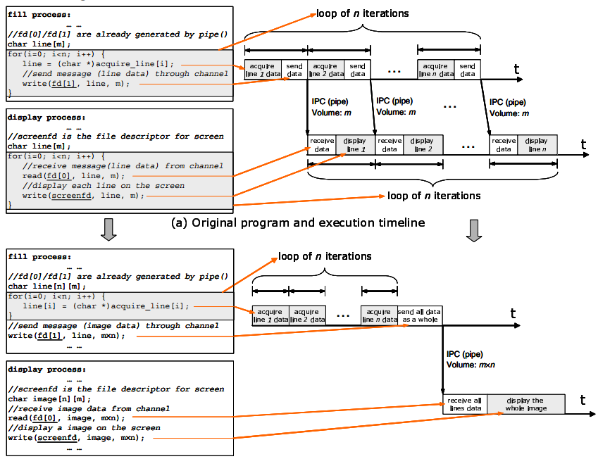
SoA (VI): Embedded
Energy-Optimizing Source Code Transformations for OS-driven Embedded Software
Dept. of Electrical Engg., Princeton University, NJ 08544
Code translation
Optimization objective
Notes:
http://ieeexplore.ieee.org/stamp/stamp.jsp?tp=&arnumber=1260934

Slide 15
Conclusions
Increasing internet connected devices
Powerful embedded systems
Objectives:
Homogeneous applications
Homogeneous visual interfaces
Universal binary concept
Write once, Deploy anywhere
Write fast once
Deploy with high performance everywhere
Converge to unified market

